Slide 1

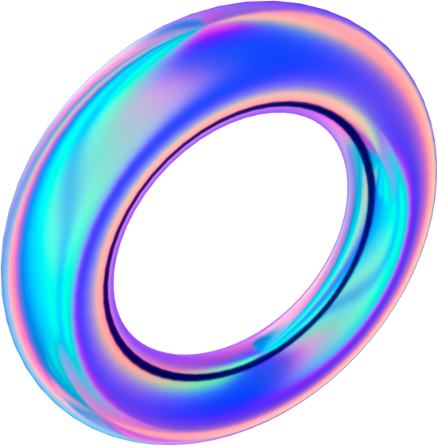


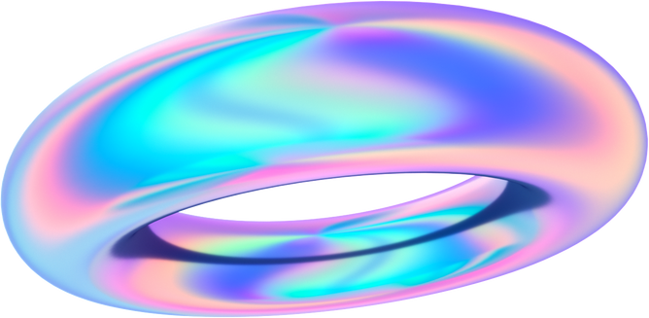

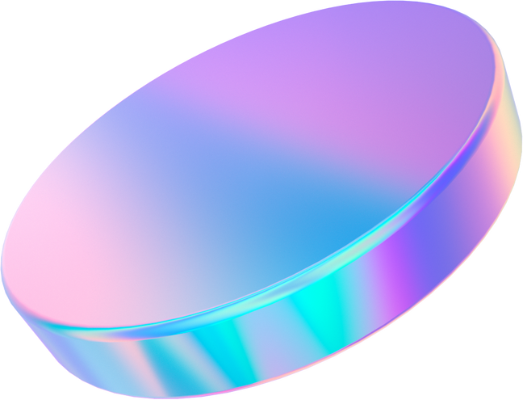
AI MINI PROJECT
Flower Identification
ANIS FARHANAH BINTI MOHD SHAMSHULBAHARIN 52213222131
DHANIA SOFIYA BINTI NIZAM 52213121119
PRABHAKARA KRISHNA DATTA KOMMU 52213122413

Slide 2
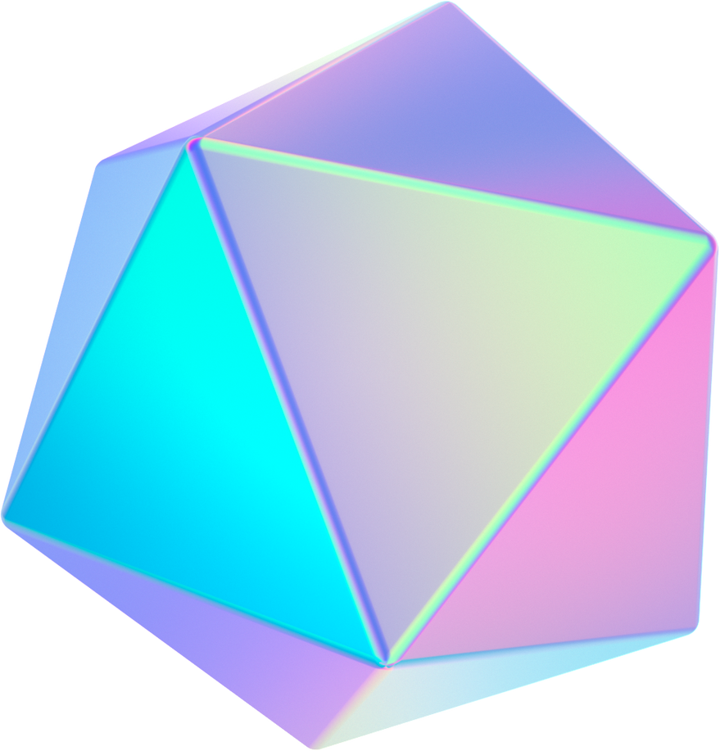
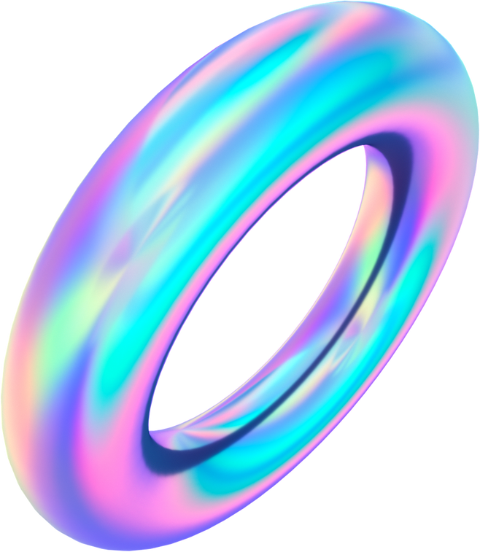
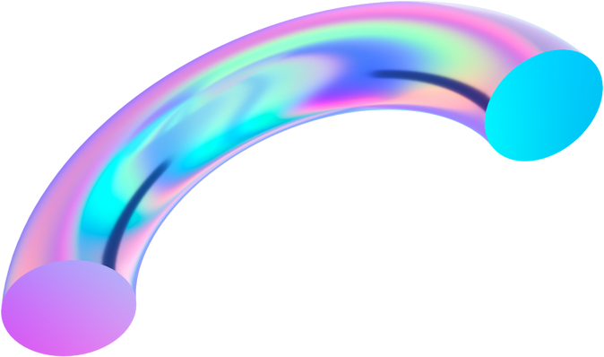
Data Collection
Used a web crawler
Done on the website Unsplash
Collected 1100 images for each class
Classes Present
Cactus
Cherry Blossom
Dahlia
Daisy
Hibiscus
Indian Lotus
Orchid
Rose
Sunflower
Tulip

Slide 3

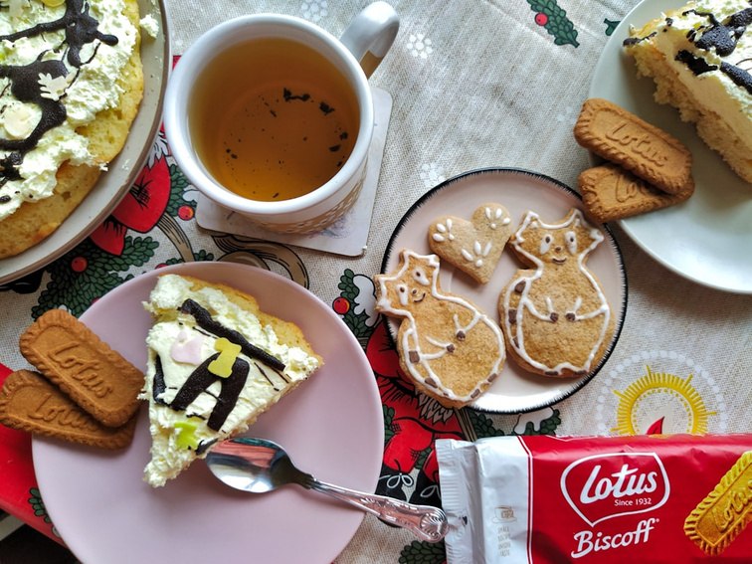

Data Cleaning
Unsuitable pictures are deleted
The best sort of pictures are kept
Some confusion are expected due to colors of flowers
Example:

Slide 4
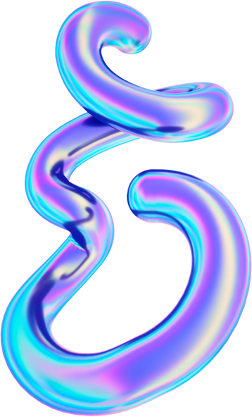
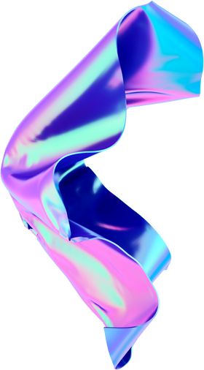

Ratio of Data
56% Train
23% Valid
21% Test
5522
2293
2092
Total images: 9907

Slide 5
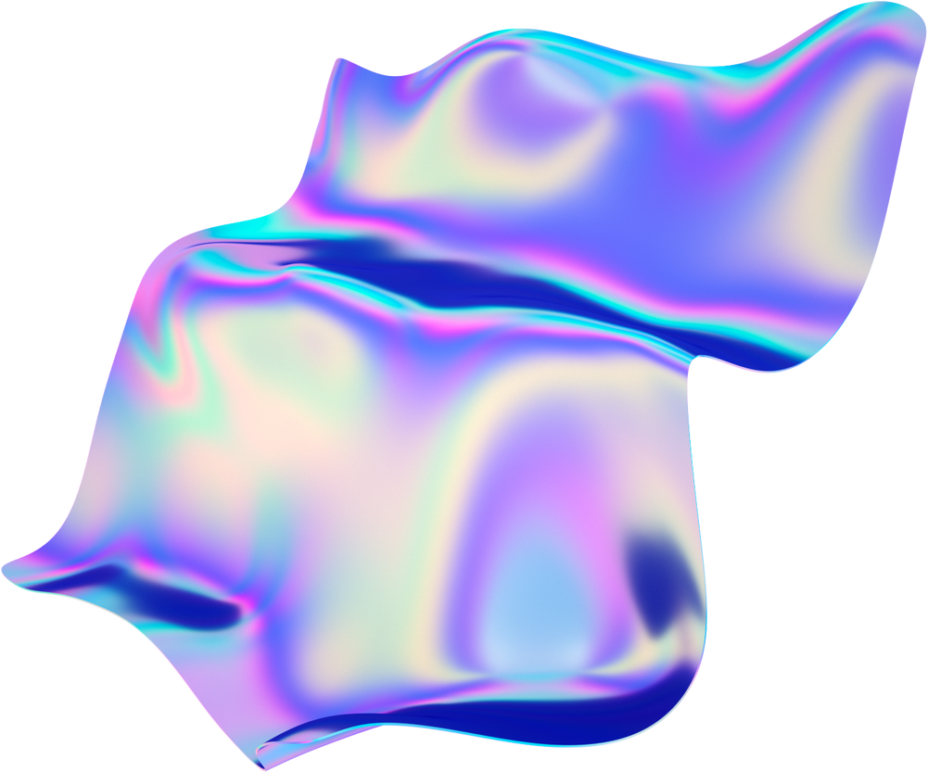
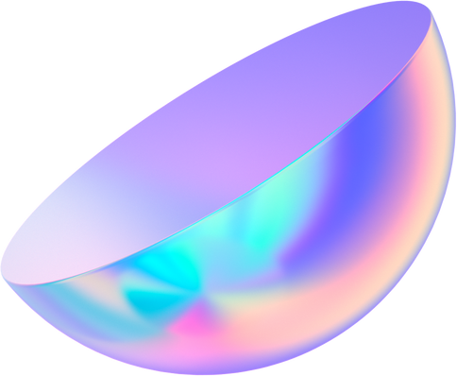
Data Modelling
ResNet50
Dense121
MobileNetv3

Slide 6
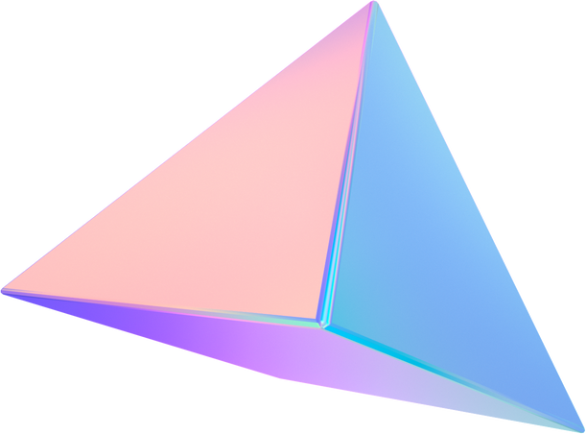
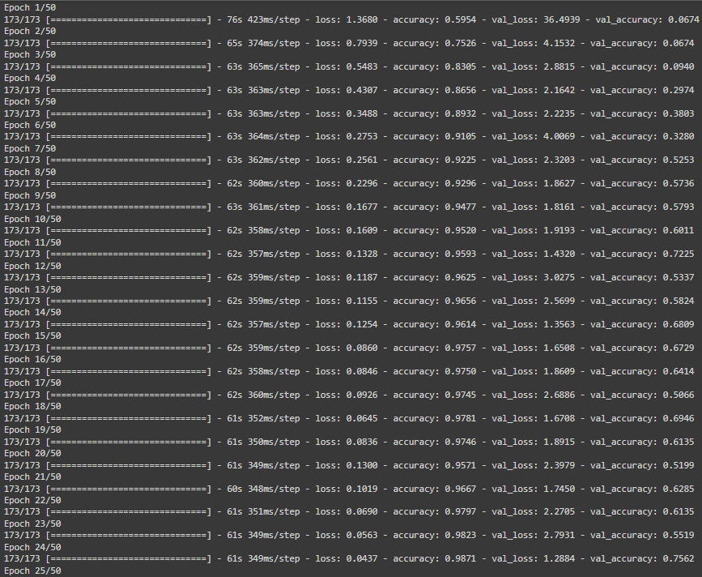
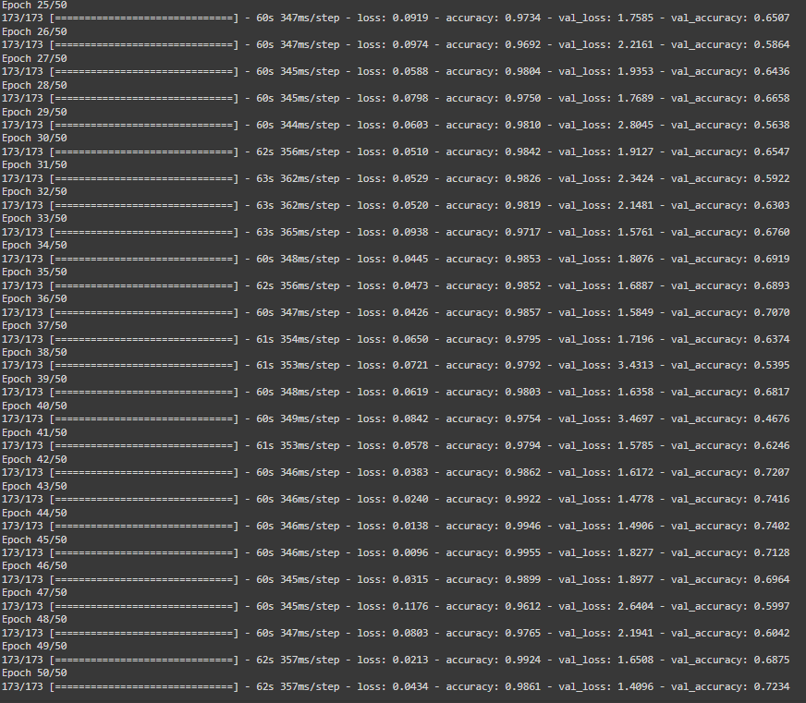
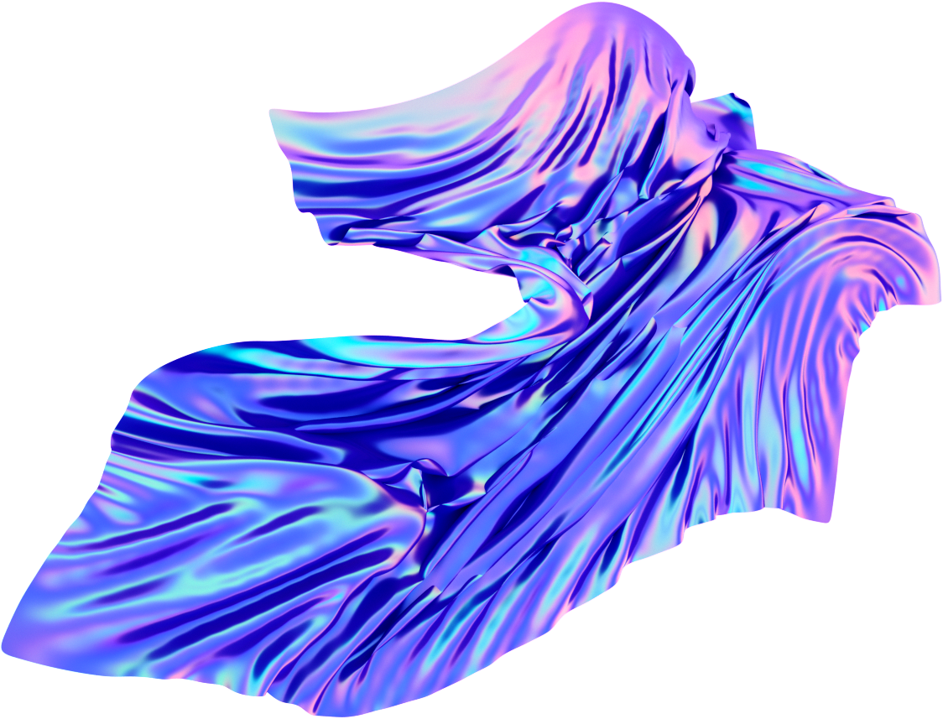
Training ResNet
Total time: 90min

Slide 7
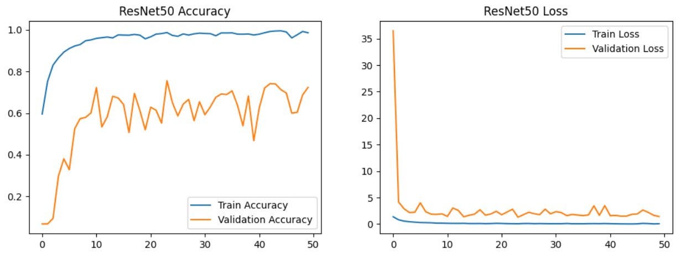
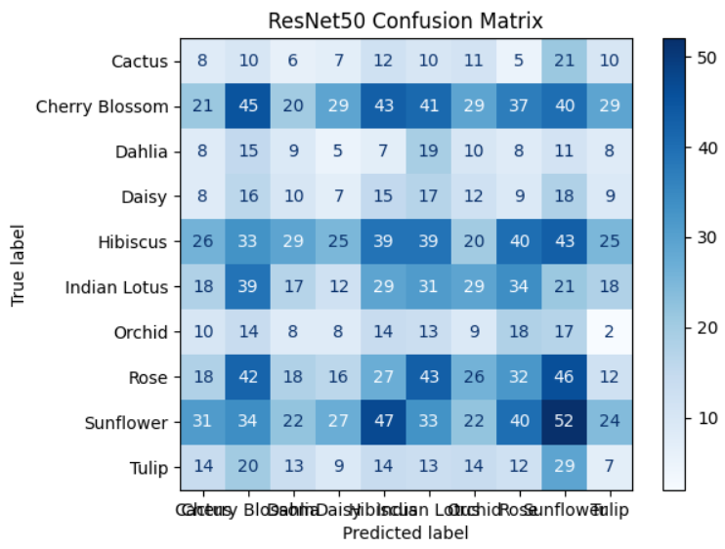
ResNet Results
Mean Average
Precision: 0.094
Major Findings
Accuracy: Accuracy approaches 1.0. Validation accuracy shows improvement, reaching 0.6. Better generalization compared to MobileNetV3.
Loss: The training loss decreases and stabilizes at low value, validation loss remains higher indicating some overfitting.
Confusion Matrix: The model shows a balanced performance across categories.
Cherry Blossom has the most correct prediction at 45.

Slide 8
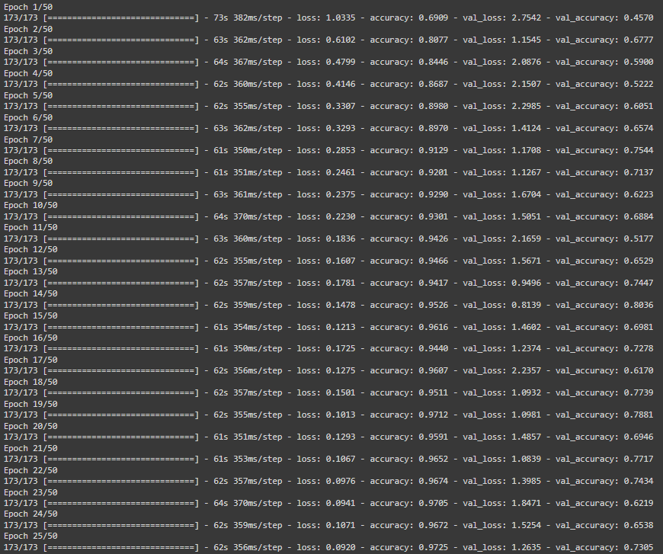
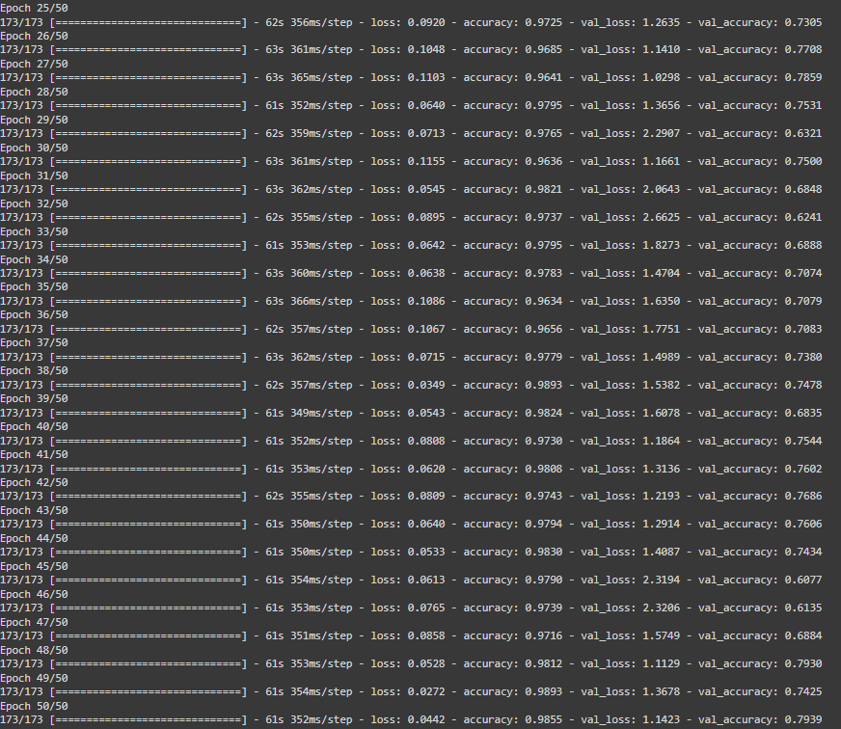
Training DenseNet
Total time: 150min

Slide 9
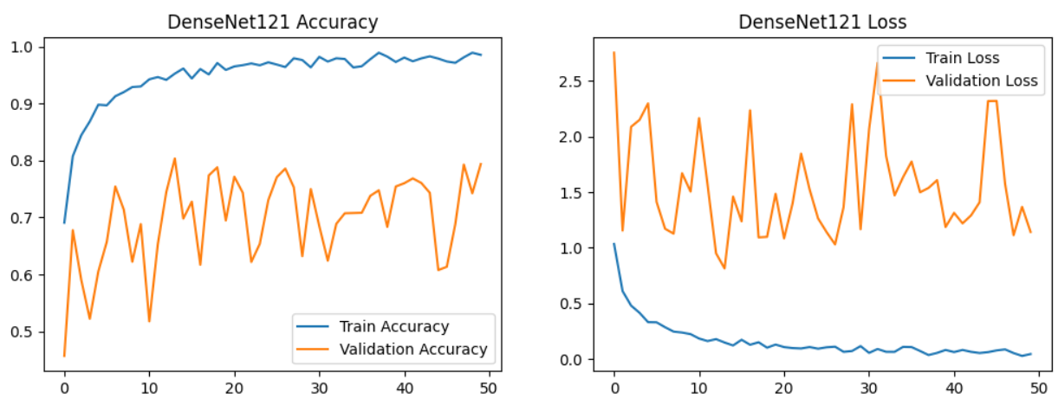
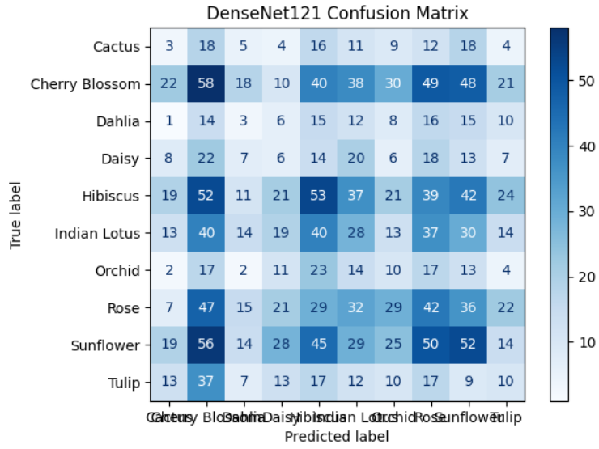
DenseNet Results
Mean Average
Precision: 0.104
Major Findings
Accuracy: Train accuracy increases near 1.0, validation accuracy improves to 0.7.
Loss: The training loss decreases and remains low, validation loss shows a more stable pattern, indicating good generalization with minimal overfitting.
Confusion Matrix: Misclassifications are still present but are less frequent compared to the other two models.
There is good generalization.
Cherry Blossom is the best category at 65 correct prediction.

Slide 10
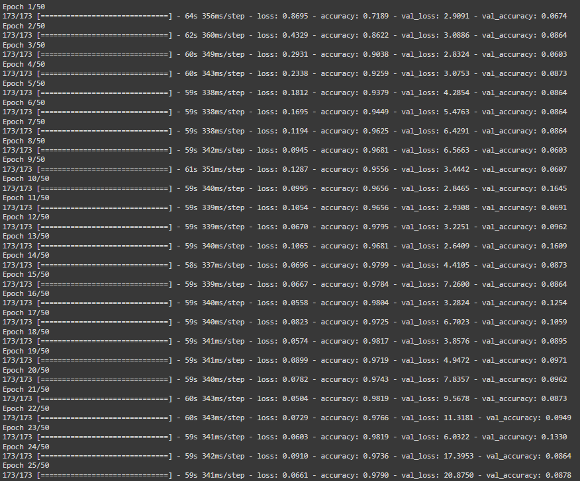
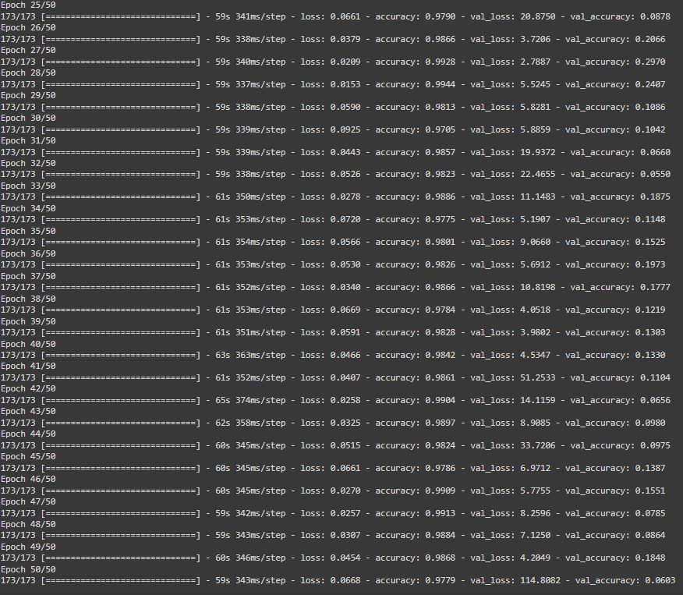
Training Mobile
Total time: 30min

Slide 11
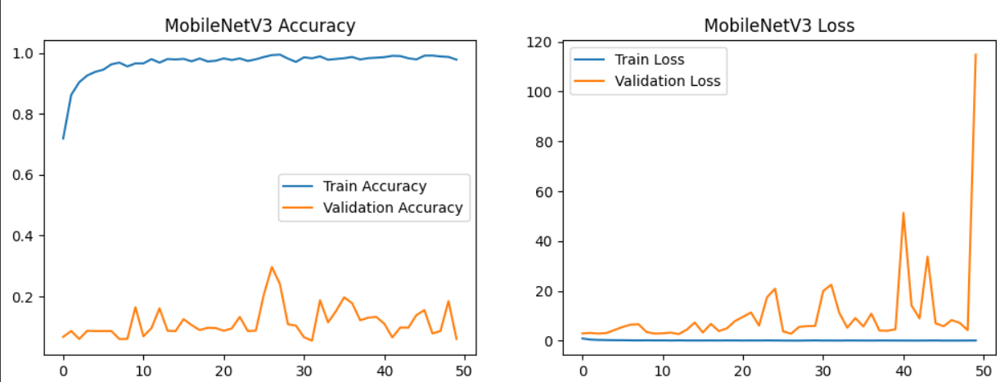
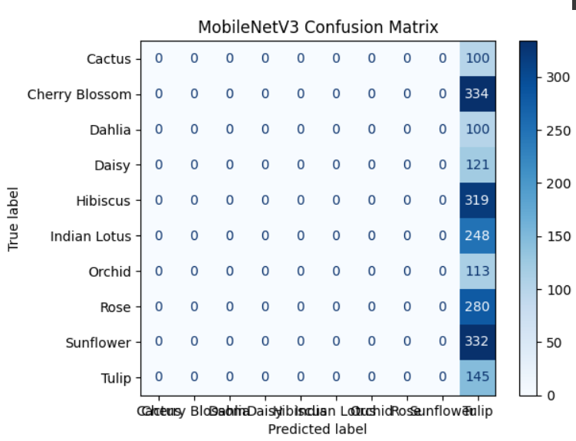
Mobile Results
Mean Average
Precision: 0.030
Major Findings
Accuracy: Accuracy approaches 1.0 quickly. Validation accuracy remains low and fluctuates around 0.2.
Loss: The training loss decreases steadily, while the validation loss fluctuates and remains high. This discrepancy indicates overfitting.
Confusion Matrix: The model correctly classifies some categories (e.g., 'Cactus' and 'Cherry Blossom'), but many show misclassification.
'Cherry Blossom' has the most correct predictions, at 286.

Slide 12
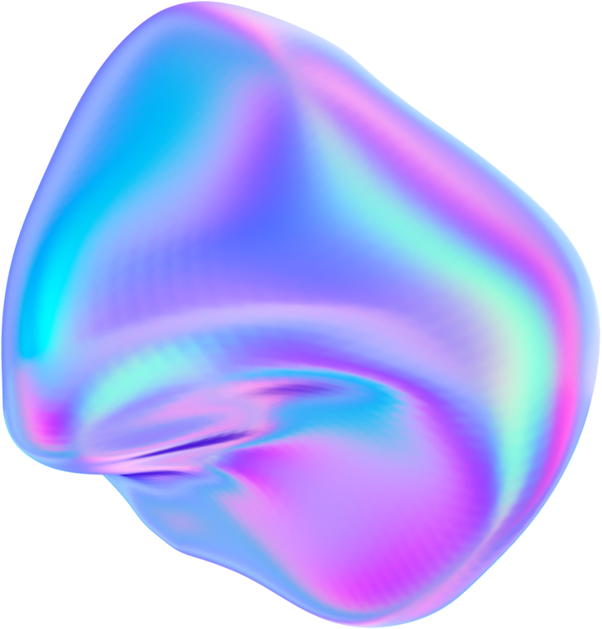
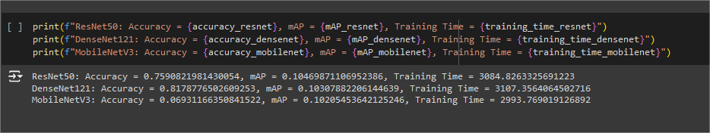
Mean Average Precision Comparison

Slide 13


Best Overall
Mid accuracy
Mid train
time
Better generalization
ResNet50

Slide 14
Conclusion
Model with the shortest training time is Mobile.
Model with the highest accuracy is DenseNet.
Model with the most balance between time and precision is ResNet.
The class with the highest correct prediction is Cherry Blossom in all models.
The class with the lowest prediction score in all models is Orchid.
The best model is decided to be ResNet.
Overfitting is an issue in all models.

Slide 15

Thank You

